Slide 1
Quantitative Sustainability: Influence on companies
introduction
Stig Irving Olsen

Slide 2

United Nation’s Sustainable Development goals
17 goals to ‘end poverty, protect the planet, and ensure prosperity for all as part of a new sustainable development agenda’
Social/economic
Environmental
Technology-driven

Slide 3
How does this influence companies?
Probably the strongest external factor industry has yet seen in the sustainability area
Should affect prioritisations and action internal in the company
SDGs are expected to be translated to national programmes containing a targeted mix of legislation, regulation, financing, and price governing mechanisms that companies have to relate to

Slide 4
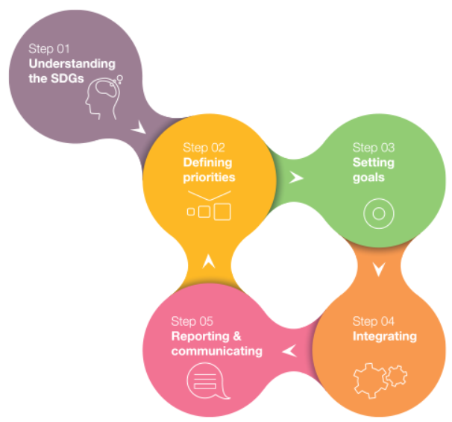
SDG Compass
Objective to support companies in aligning their strategies with the SDGs and in measuring and managing their contribution
Developed by GRI, the UN Global
Compact and the World Business
Council for Sustainable Development
(WBCSD)

Slide 5
Sustainable alternatives have various advantages.
It will create direct value by reducing energy costs and reduced waste processing costs, and by avoiding pollution taxes that embraces CSR.
It will diminish vulnerability regarding future energy costs and other material costs as one would consume less.
It will be the basis for a sound and positive reputation.
It might result in a stronger company spirit and a collective company goal improving the company’s synergy.
It will facilitate the acquirement of licenses.
It will stimulate learning and innovation. New opportunities and emerging markets
Last but not least, it will lead to more employee satisfaction. It can fulfill people’s desire for good citizenship. Personal motivation of management and other employees can increase, improving social behavior and other business results.

Slide 6
Some academic studies
Yu et al, 2015
positive relation between sustainability performance and firm value, after controlling for variables that have been found to affect firm value in the existing literature.
Lourenco et al, 2012
Their findings suggest that CSP is positively associated with the financial performance of large and profitable firms which are able to signal their sustainability performance, and has a negative association with the performance of large and profitable firms that are not able to signal their sustainability performance.
CSP has significant explanatory power for stock prices over the traditional summary accounting measures such as earnings and book value of equity.
Lo & Sheu, 2007
a significantly positive relation between corporate sustainability and its market value is found. We also find a strong interaction effect between corporate sustainability and sales growth on firm value.

Slide 7
Different initiatives to engage in
UN Global Compact
Science Based Targets Initiative
In buildings - DGNB
Etc

Slide 8
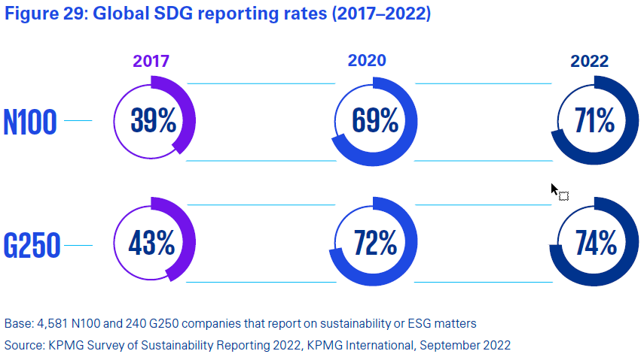

Slide 9
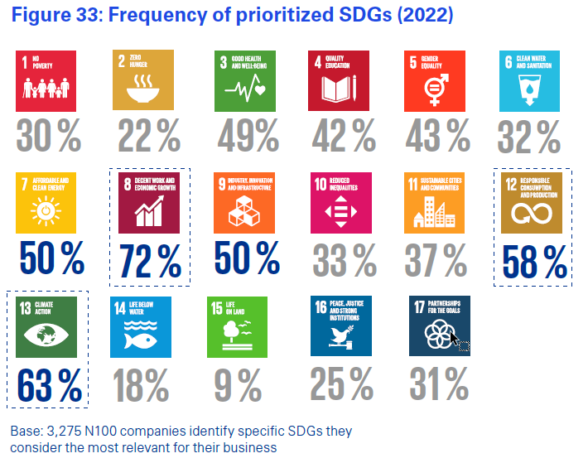

Slide 10
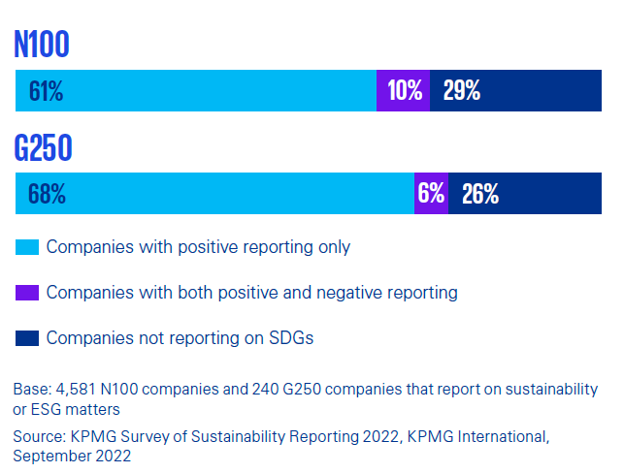

Slide 11
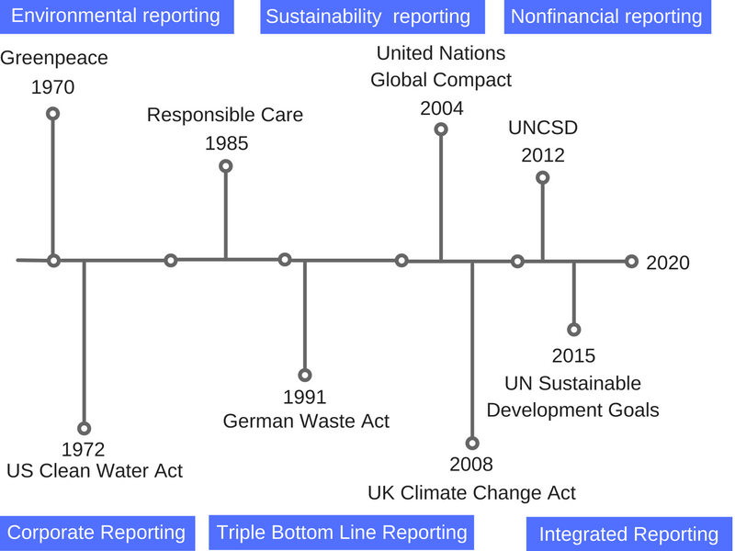
Reporting
NFRD, 2014
CSRD, 2024

Slide 12
Nasdaq ESG (environmental, social and governance) REPORTING GUIDE

Slide 13
Streamlining diverse approaches
EU Requirements
Corporate Sustainability Reporting Directive
Non-Financial Reporting Directive
How?
European Sustainability Reporting Standards
Technical Screening Criteria

Slide 14
Non-financial reporting requirements
EU-directive
>500 employees (from 2025 >250 employees; from 2026 all quoted companies)
Business model and strategy
Sustainability policies
Performance:
environmental matters
social matters and treatment of employees
respect for human rights
anti-corruption and bribery
diversity on company boards (in terms of age, gender, educational and professional background)
……
EU reporting standards ESRS developed by European Financial Reporting Advisory Group (EFRAG)

Slide 15
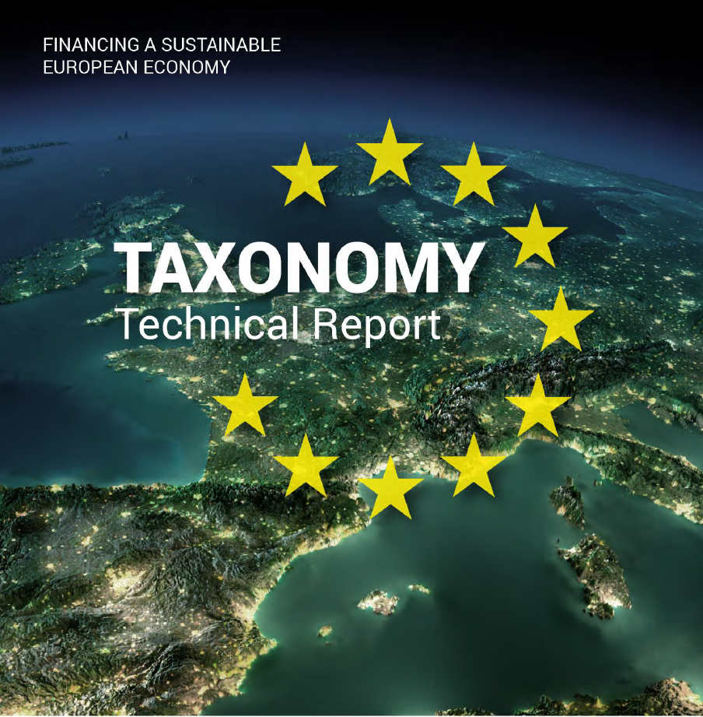
European Taxonomy for sustainable investment

Slide 16
Taxonomy Regulation
environmental objectives:
1. climate change mitigation;
2. climate change adaptation;
3. the sustainable use and protection of water and marine resources;
4. the transition to a circular economy;
5. pollution prevention and control;
6. the protection and restoration of biodiversity and ecosystem
Social objectives (to come):
1. employees;
2. customers;
3. sustainable and inclusive communities

Slide 17
Take home messages
Engaging in sustainability can have positive effect on companies
An increasing focus on sustainability from society incl. Authorities
Requirements for non-financial reporting

